Slide 1
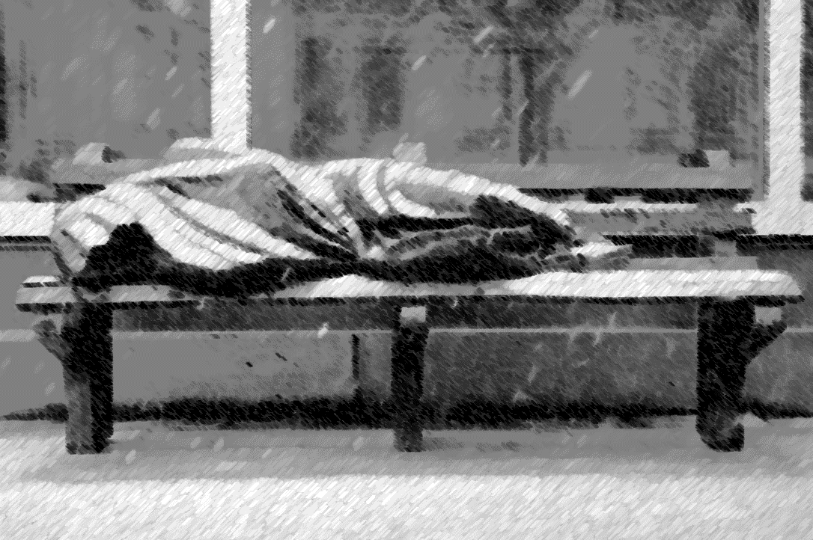
Potential Venues for Homeless Shelters in the City of Toronto
Capstone project by Yael Valdez navarro

Slide 2
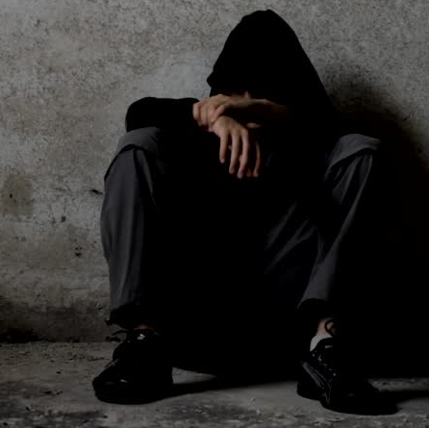
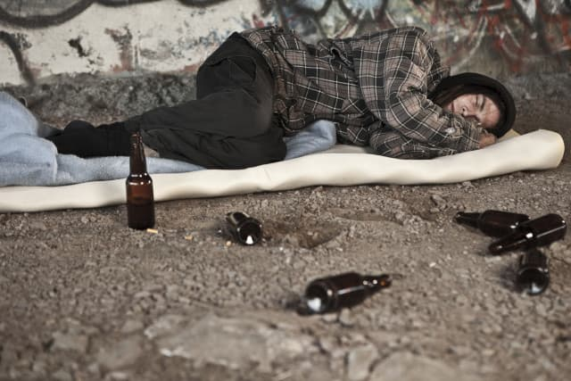
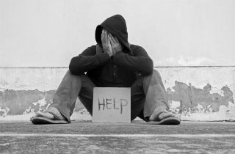

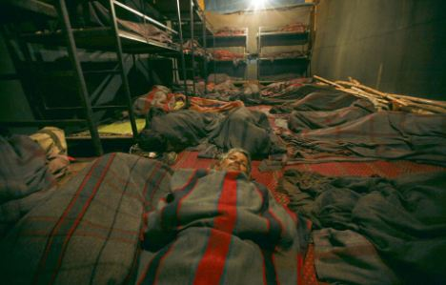
An overlooked problem..
Depression | Drug-use | Abusive-situations | Mental-illness | crowded
26% had been hospitalized with an average of 5 times for an emotional or mental health problem | 21% indicated that they were receiving help on drug treatment | 43% of respondents indicated that addressing their health needs was important | 35% of respondents had been diagnosed with at least one mental health condition | Toronto’s shelters operate at 98% capacity every day
1: https://www.homelesshub.ca/blog/what-are-statistics-homelessness-and-mental-health-toronto
2: https://www.fredvictor.org/facts-about-homelessness-in-toronto/

Slide 3
Opening new shelters is of value to this marginalized group
Problem: Considering the points shown, it is of interest for charities, non-profit organizations and the city of Toronto to fund new homeless shelters. The question is, where?
For this project, selection is based upon different criteria, such as:
Accessibility: The ideal venue should be close to public transport, train stations or bus stops.
Socio-economic: It has been shown that low income areas are hot-spots for homelessness, specially with increasingly prohibitive rent costs.
Geographic: Identify “trends” in neighborhoods which have high prevalence of homelessness.
Goal: Provide a venue location, pinpointing general latitude, longitude and neighbourhood.

Slide 4
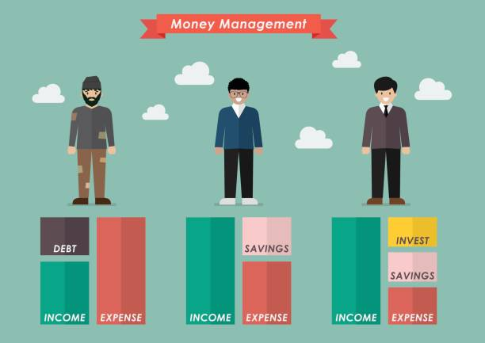


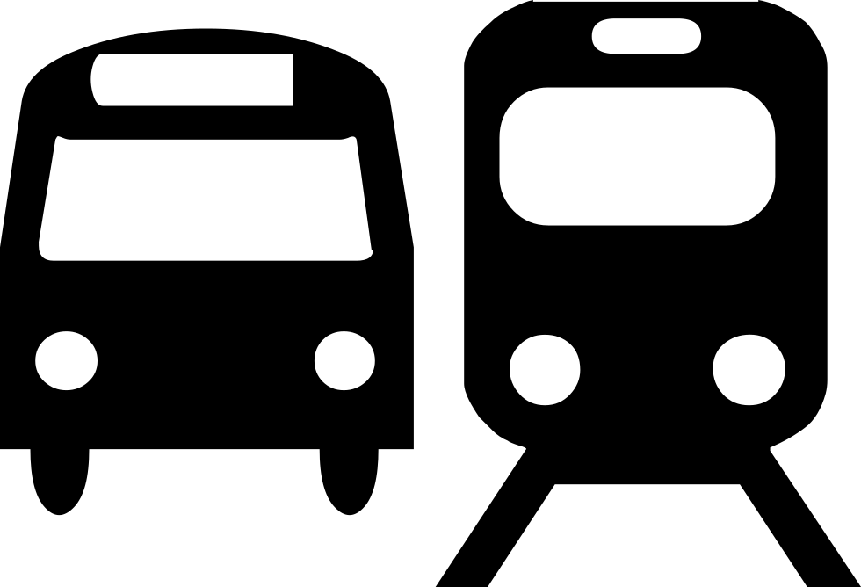
Data
Socio-Economic:
Neighbourhood profiles from Toronto Open Data initiative (TOD) –Features pertaining only to economic indicators selected
Original size: 146 cols x 946 rows
Reduced size: 25 cols x 140 rows
Geographic:
Toronto geojson from Github user adamw523 – Neighbourhood names updated to comply with TOD’s file
Shelter locations from TOD, converted to csv with online tool
Accessibility:
Foursquare – Used to query train, bus and streetcar stations
Which are the sources?
1. Socio-economic
2. Geographic
3. Accessibility

Slide 5
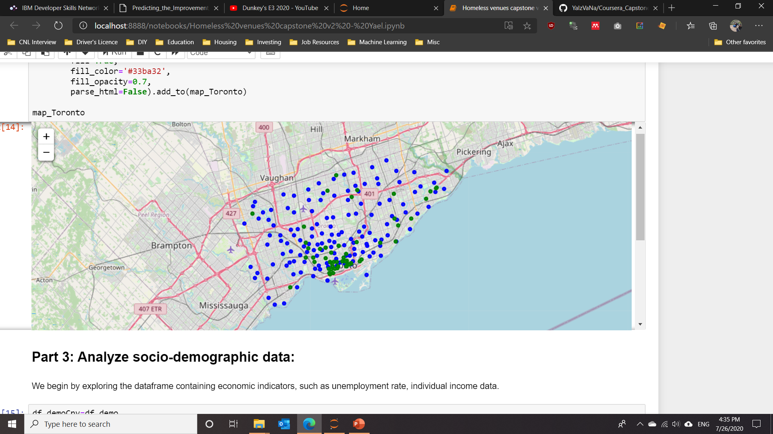
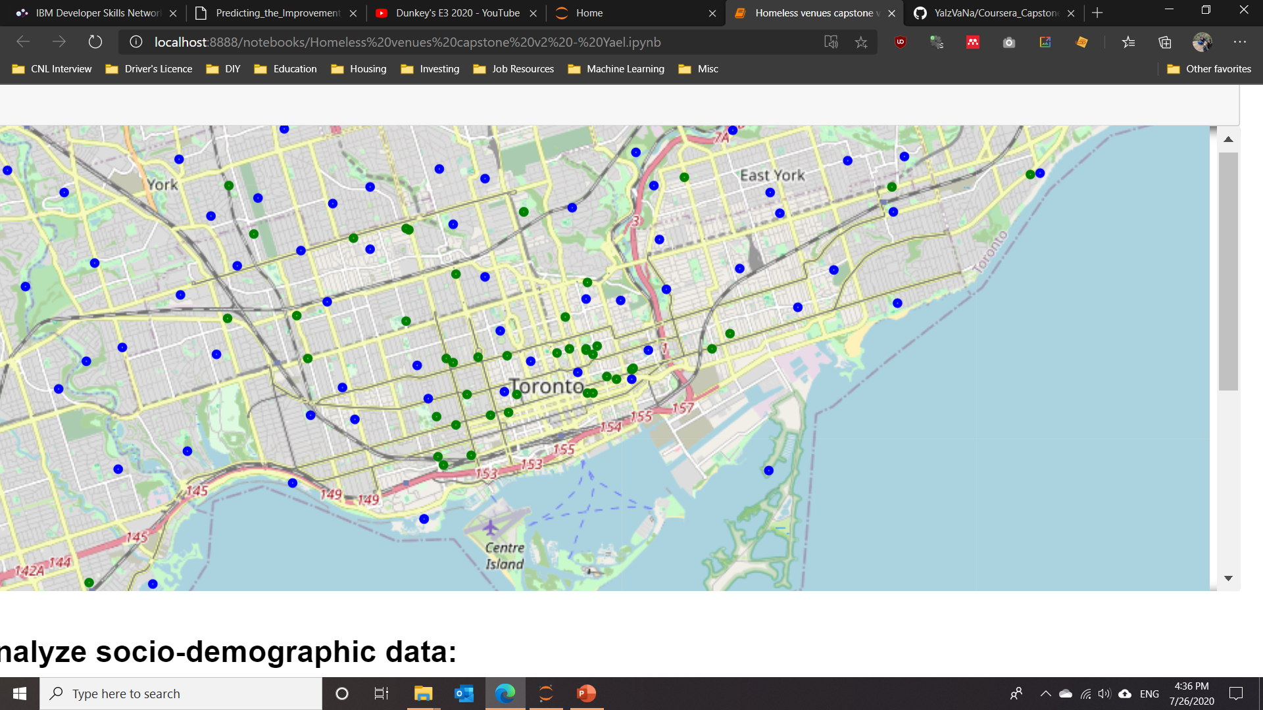
Where are neighbourhoods and shelters located?
Overview
We see a trend of shelters highly agglomerating on Toronto’s main downtown zone
Downtown

Slide 6
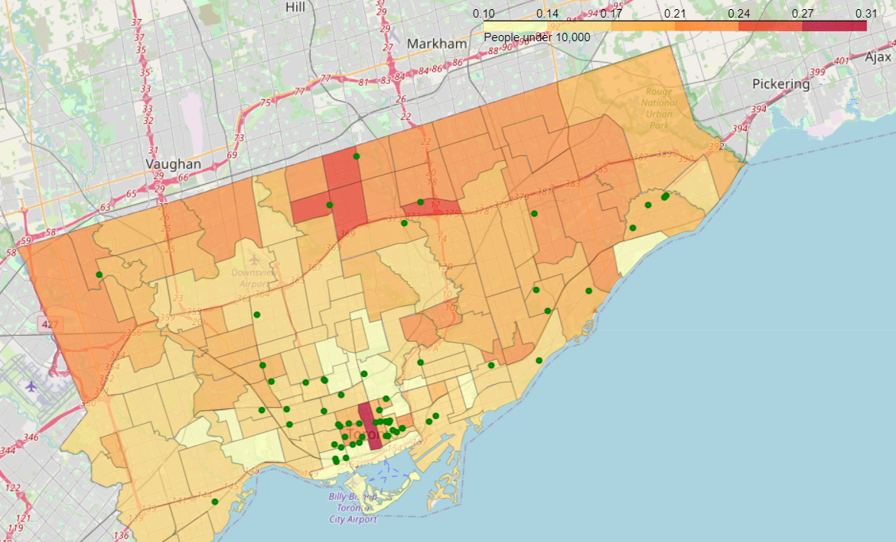
Exploring socio-demographic statistics
People under 10,000:

Slide 7
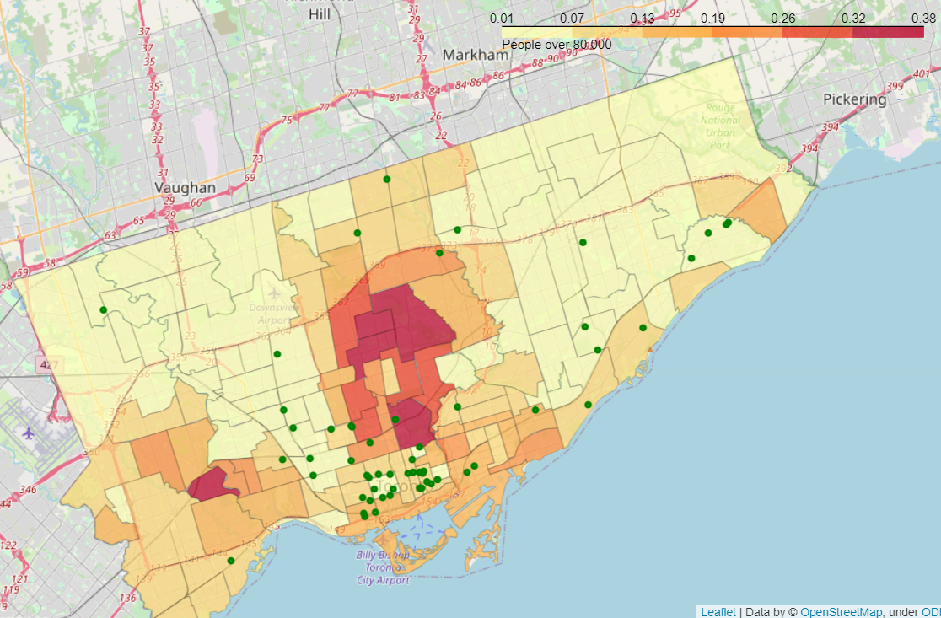
Exploring socio-demographic statistics
People over 80,000:

Slide 8
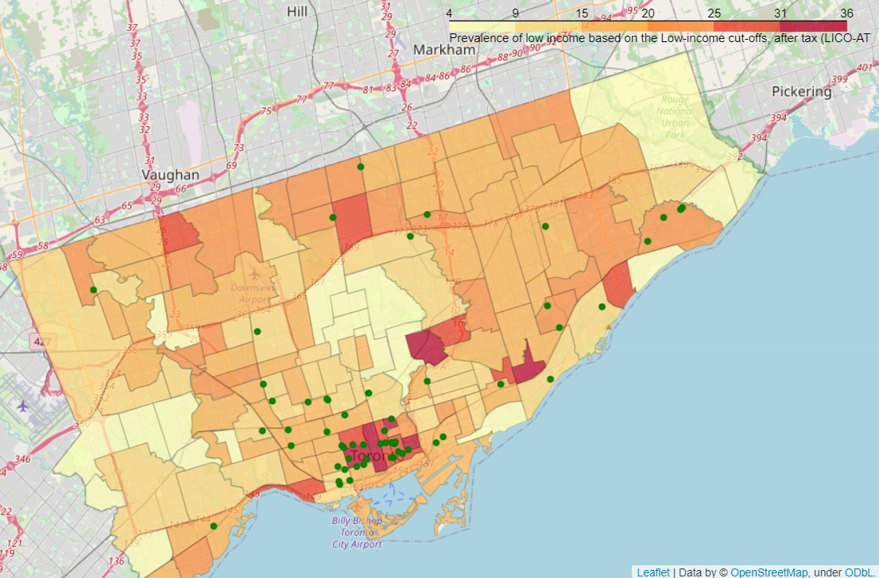
Exploring socio-demographic statistics
Prevalence of low income based on LICO-AT:

Slide 9
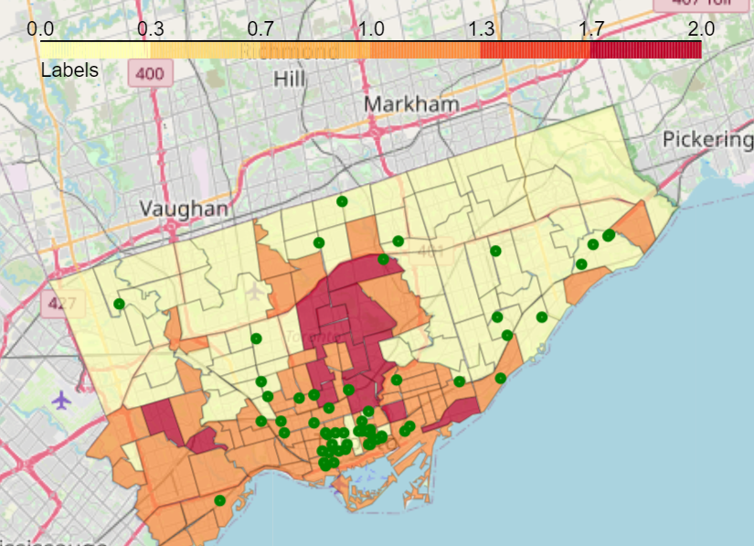
How are neighbourhoods clustered?
Cluster 0
Cluster 1
Cluster 2
Homeless shelters
NOTE: Features included in k-means algorithm do NOT include latitude and longitude info, yet neighbourhood clusters are agglomerated close to each other geographically.

Slide 10
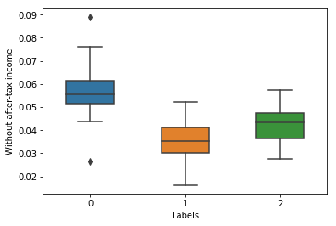
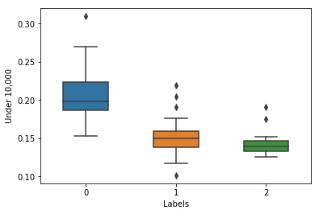
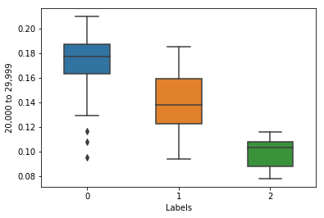
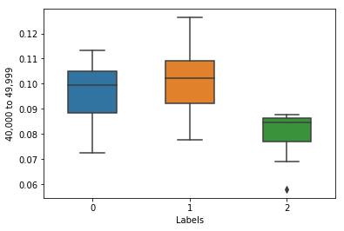
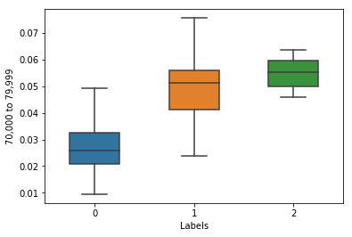
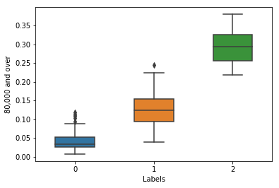
What is the difference between the clusters?
Let’s look at incomes
Blue – Cluster 1
Orange - Cluster 2
Green - Cluster 3
An overview:
Cluster 1 ~ low income
Cluster 2 ~ mid income
Cluster 3 ~ high income

Slide 11
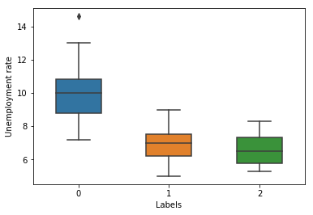
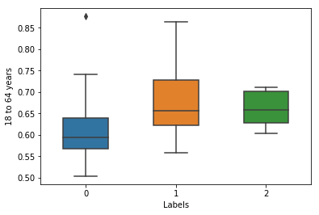
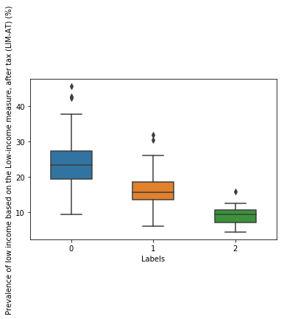
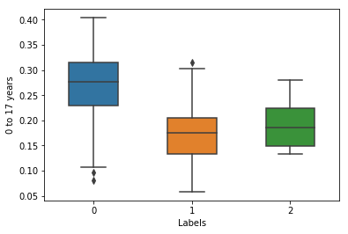
What is the difference between the clusters?
And now we check labour statistics
Blue – Cluster 1
Orange - Cluster 2
Green - Cluster 3
An overview:
Cluster 1 ~ high unemployment, high prevalence of young people with low income
Cluster 2 ~ unemployment ≈ Cluster 3, medium prevalence
Cluster 3 ~ unemployment ≈ Cluster 2, very low prevalence of low income

Slide 12
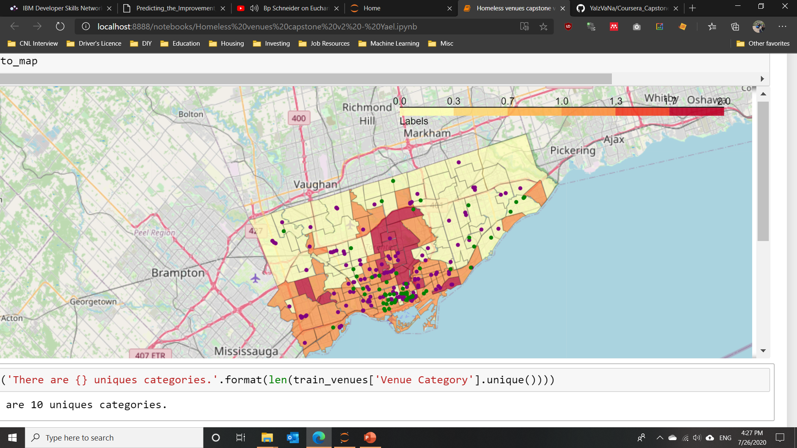
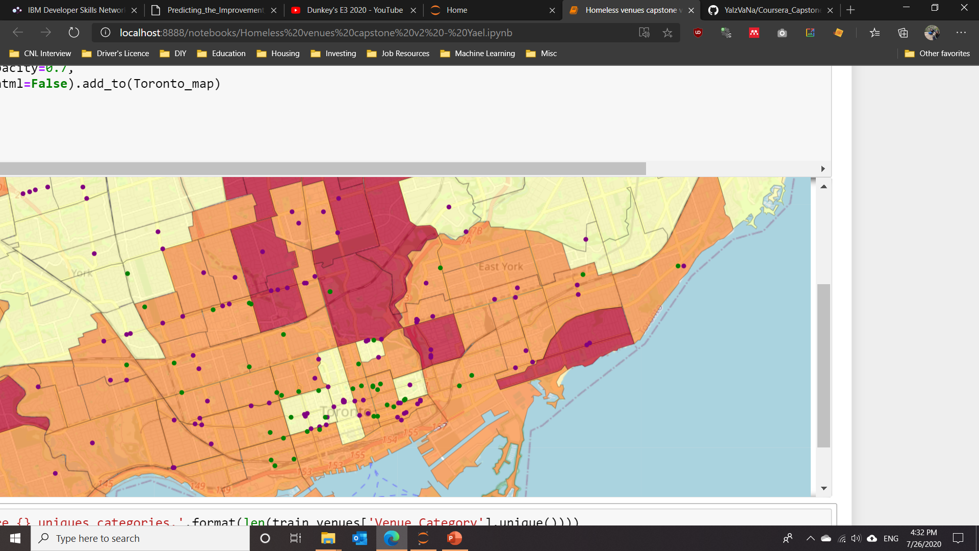
How do clusters and public transit stations agglomerate?
Foursquare returns several public stations, a better alternative would be to directly obtain a dataset with the full stations.

Slide 13
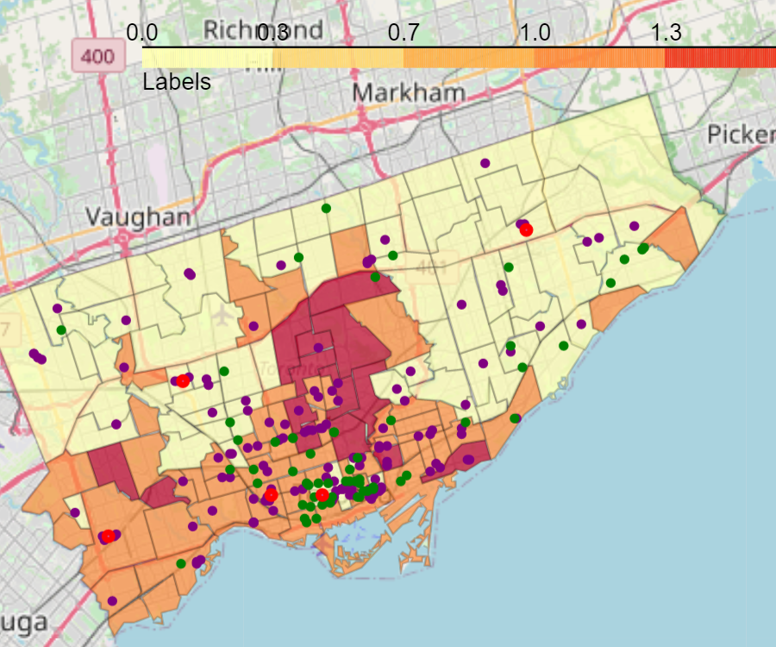
Where should a new venue be located?
New venues – 5 new venues located in clusters 0 and cluster 1, located close to public transit stations agglomerations.

Slide 14
Conclusions
New venues were recommended based on the obtained clusters and closeness to public transit stations
Features which are highly correlated could be eliminated to improve clusters
An indicator for income inequality could be calculated to improve clustering

